Slide 1
Crowd Science Mapper
Team: Hannah Aker and Jiasong Yan
Sponsors: Dr. Mengyu Qiao and Gail Schmidt

Slide 2
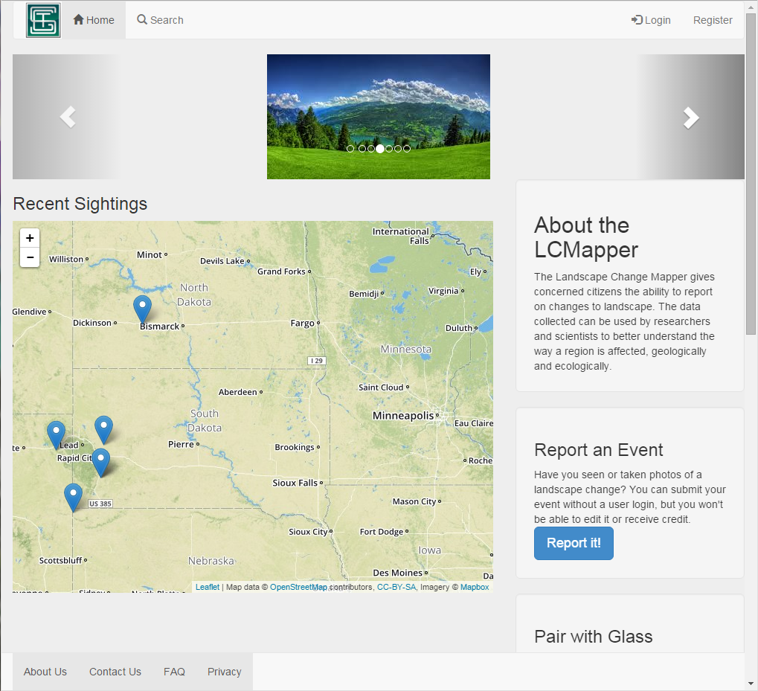
Currently: The Landscape Change Mapper

Slide 3
Project Goal
improve on the idea originally presented in the Landscape Change Mapper, and expand on it to create a flexible interface for other kinds of events
Notes:
jy

Slide 4
User Needs
Maintain core functionality:
Visual map representation of events
Detailed event list
Event reporting interface
New user registration
User login
Add new functionality:
Select set of events to view
Administrator customization of a set of events
Administrator editing existing event reports
Notes:
jy

Slide 5
Timeline
Sprint 1:
Basic User Interface
Analyze old project code
Sprint 2-4:
Get old project code ready for new functionality
Sprint 5-6:
Implement new features
Notes:
jy

Slide 6
Technical Aspects
New Database Design
HTML, PHP and Java Script to connect to Mongo Database, and hosted on Apache 2.2 Server, source control and project planning through GitHub
Will need to revise database design for different event sets
Notes:
jy

Slide 7
Testing
Not much in first sprint to test, will implement a testing matrix, and manually test program each sprint.
Notes:
jy

Slide 8
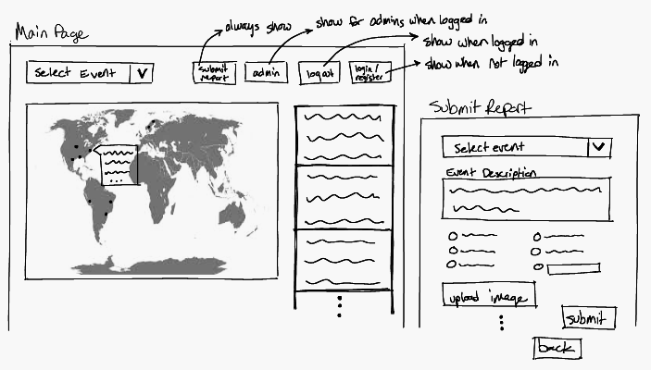
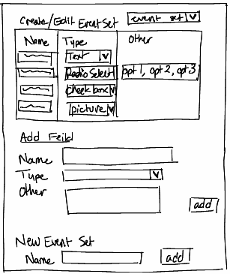
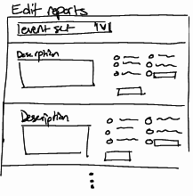
Webpage Design

Slide 9
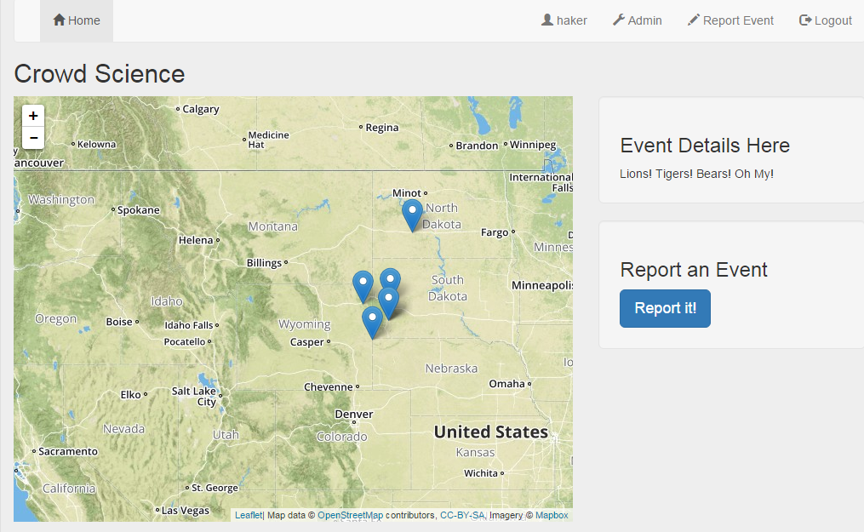
Prototype

Slide 10
Intellectual Property
Hardware
Intellectual property belongs to SDSM&T
The server is a cloud server at SGT. No other hardware is required.

Slide 11
Successes
Problems
Started analyzing old code, started new UI, started requirements section of documentation
Cloud server got shut down on accident

Slide 12
Next Sprints
Continue analyzing old code and implementing old features in the new project.

Slide 13
Questions?

